Slide 1
Chapter 2
Network Models

Slide 2
The main responsibility of computer network is to enable two processes, which are not in same computer, to communicate.
So in computer networks, we are providing both H/W and S/W functionalities to these processes.
There are nearly around 70+ such functions. Some are mandatory and some are optional functionality.
Hence, we need to think about, how to implement them, where to implement them. What are the sets of functionalities which are closely related to each other. What are the sets of functionalities which are not closely related to each other.

Slide 3
So depending upon all these functionalities and their grouping, we have some reference models.
ISO/OSI Reference Model
TCP/IP Reference Model
ATM
X.25
IEEE (LAN Technologies)

Slide 4
The ISO/OSI Model
ISO/OSI – International Standard Organization/ Open System Inter-connection.
Now when we have so many functions to implement, it is better to put all the closely related functions and form their group.
So that it is easy for us to implement them.

Slide 5
2-1 LAYERED TASKS
We use the concept of layers in our daily life. As an example, let us consider two friends who communicate through postal mail. The process of sending a letter to a friend would be complex if there were no services available from the post office.
Topics discussed in this section:
Sender, Receiver, and Carrier Hierarchy

Slide 6
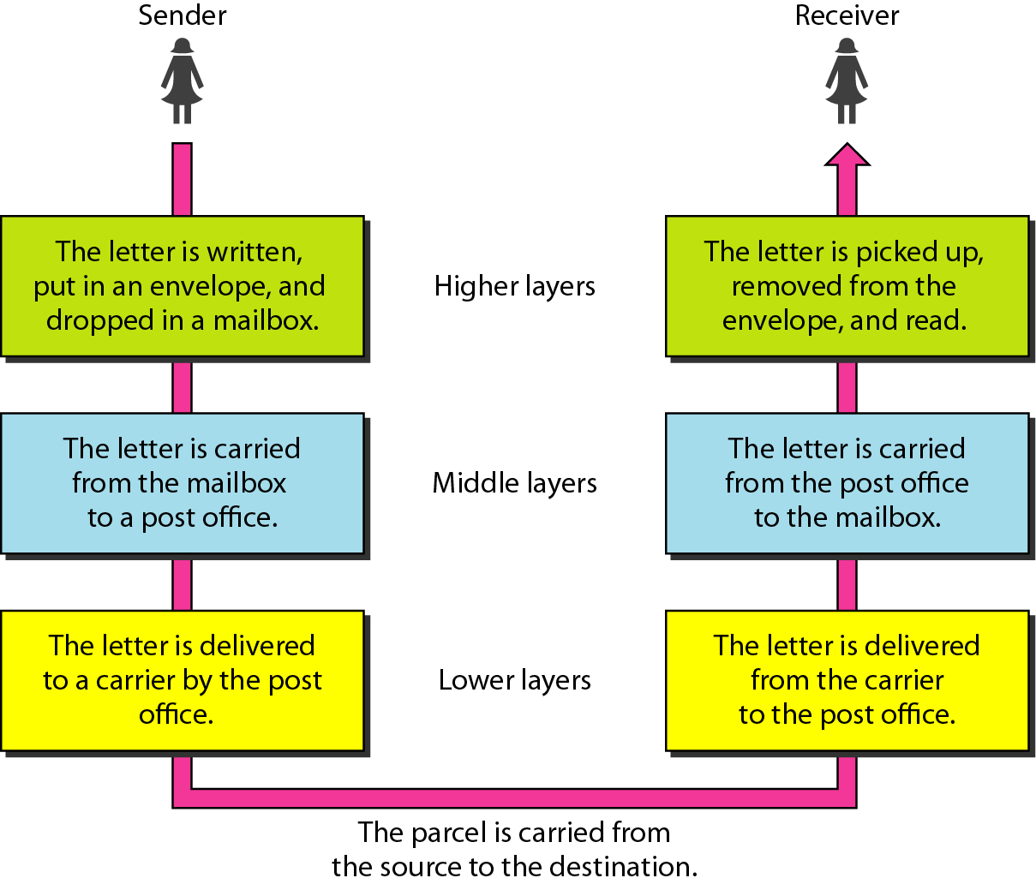
Figure 2.1 Tasks involved in sending a letter

Slide 7
2-2 THE OSI MODEL
Established in 1947, the International Standards Organization (ISO) is a multinational body dedicated to worldwide agreement on international standards. An ISO standard that covers all aspects of network communications is the Open Systems Interconnection (OSI) model. It was first introduced in the late 1970s.
Topics discussed in this section:
Layered Architecture Peer-to-Peer Processes
Encapsulation

Slide 8

Note
ISO is the organization. OSI is the model.

Slide 9
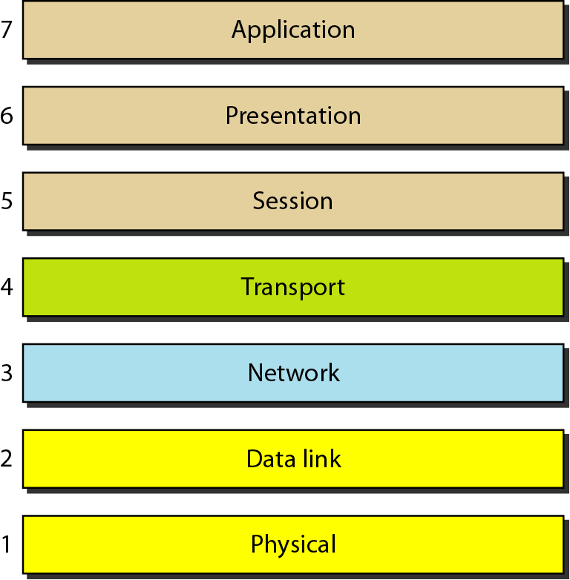
Figure 2.2 Seven layers of the OSI model

Slide 10
Advantages of classifying into layers:
-- Divide & Conquer Technique
-- Encapsulation
-- Abstraction
-- Testing

Slide 11
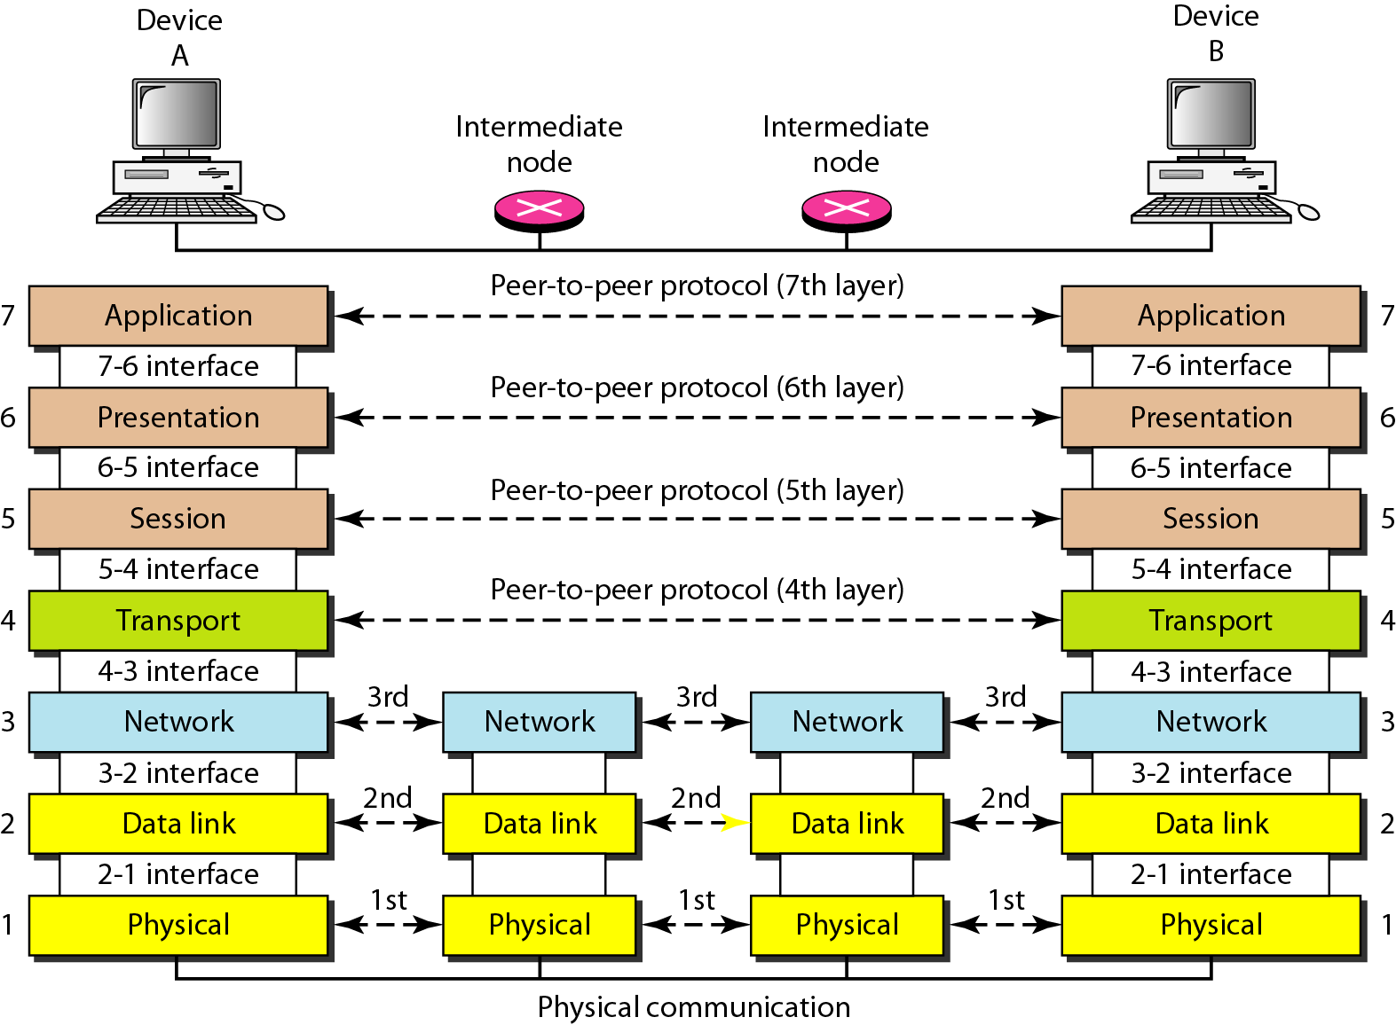
Figure 2.3 The interaction between layers in the OSI model

Slide 12
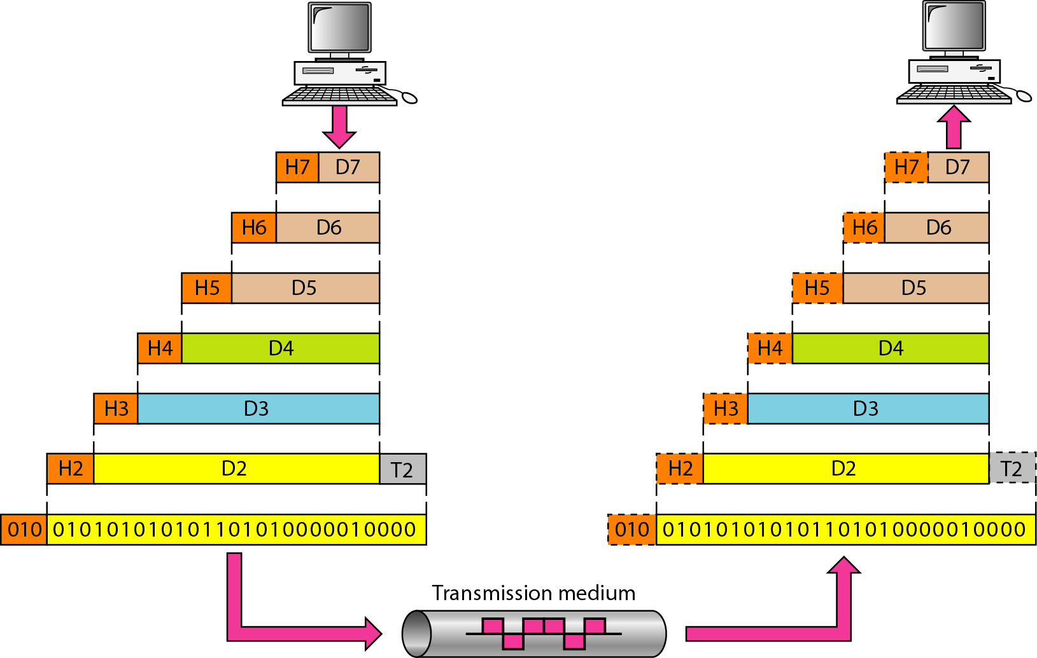
Figure 2.4 An exchange using the OSI model

Slide 13
2-3 LAYERS IN THE OSI MODEL
In this section we briefly describe the functions of each layer in the OSI model.
Topics discussed in this section:
Physical Layer Data Link Layer
Network Layer
Transport Layer
Session Layer
Presentation Layer
Application Layer

Slide 14
Functions of Physical Layer (Layer-1)
The physical layer coordinates the functions required to carry a bit stream over a physical medium.
Physical Layer deals with
Electrical characteristics
Mechanical characteristics
Functional characteristics
Procedural characteristics
of a physical link.
If physical link is of type copper – That means if you are sending your message over copper wire, then message has to be converted into electrical signal. Or if it is of type optical fibre, then the message has to be converted into light. Or if available link is wireless then the message has to be converted into electromagnetic waves.
So depending on what is the type of link is available; the signals are converted accordingly.

Slide 15
Functional & Procedural characteristics means: which type of transmission modes we can use.
Physical Layer also deals with Network topologies:- logically how devices are connected.
Physical Layer also deals with encoding and representation of bits:- given 1’s and 0’s data, how are you going to convert them into waves or electrical signal and send them.
We have two ways to encode the bits:
Manchester Encoding
Differential Manchester Encoding

Slide 16
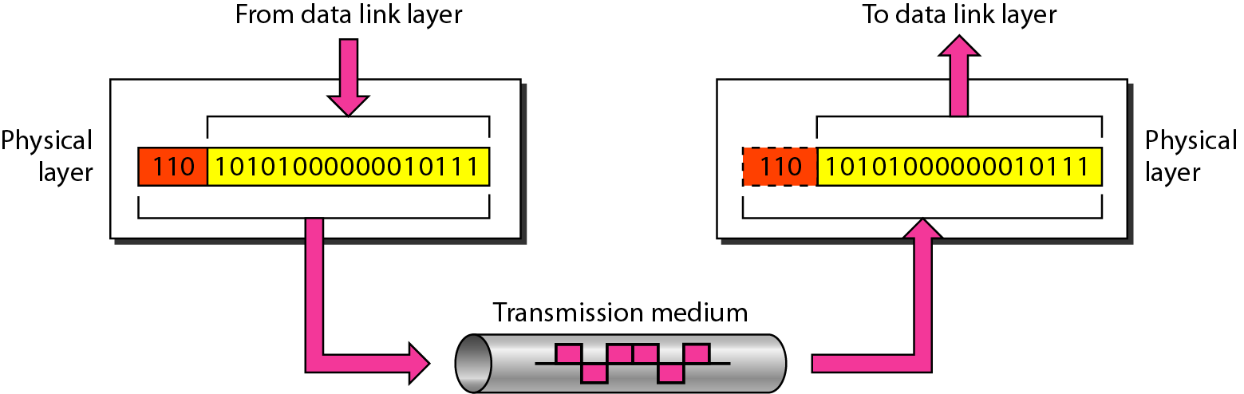
Figure 2.5 Physical layer

Slide 17
Functions of Data Link Layer (DLL) (Layer-2)
The data link layer is responsible for moving frames from one hop (node) to the next.
The responsibilities of the data link layer include the following:
Framing
Physical addressing
Flow control
Error control
Access control

Slide 18
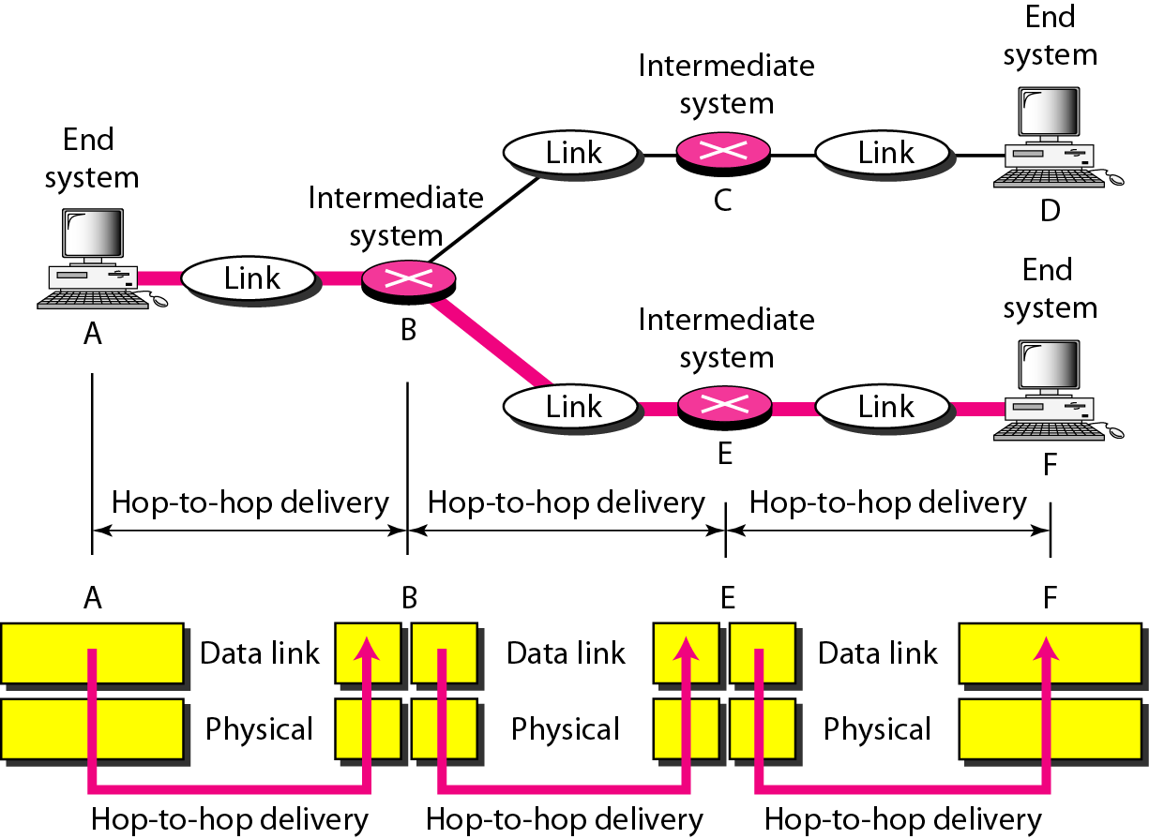
Figure 2.7 Hop-to-hop delivery

Slide 19
Functions of Network Layer (Layer-3)
The network layer is responsible for the source-to-destination delivery of a packet, across multiple networks.
However, the data link layer oversees the delivery of the packet between two systems on the same network.
The responsibilities of the network layer includes the following:
Logical Addressing
Routing/Switching

Slide 20
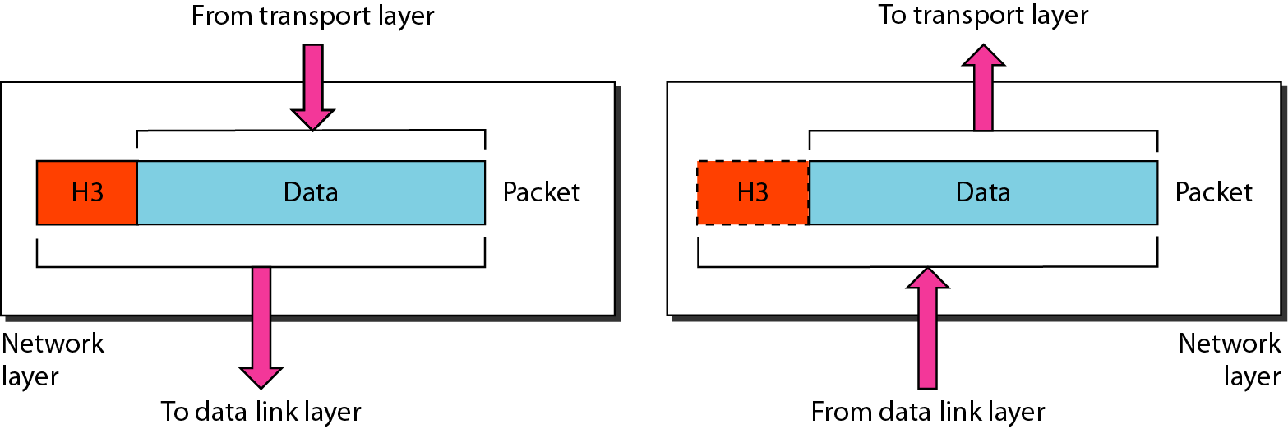
Figure 2.8 Network layer

Slide 21
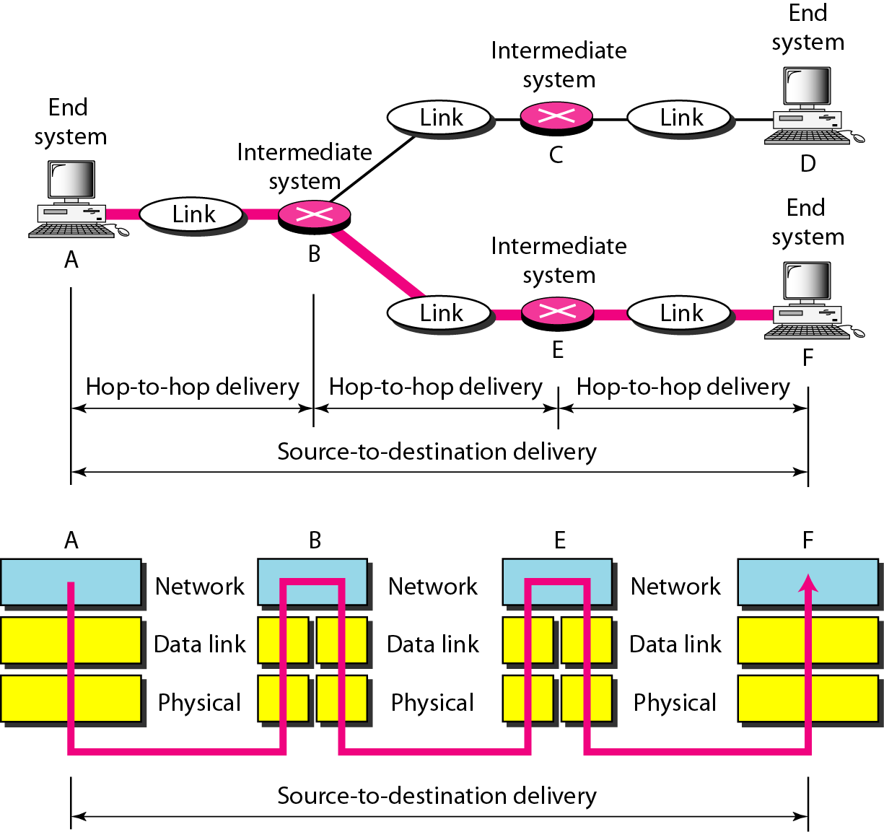
Figure 2.9 Source-to-destination delivery

Slide 22
Functions of Transport Layer (Layer-4)
The transport layer is responsible for process-to-process delivery of the entire message.
Whereas the network layer oversees source-to-destination delivery of individual packets, it does not recognize any relationship between those packets.
Network layer treats each packet as independent entity.
The transport layer, on the other hand, ensures that the whole message arrives intact and in order.
The responsibilities of the transport layer includes the following:
Service-point addressing
Segmentation and Reassembly
Error and Flow control

Slide 23
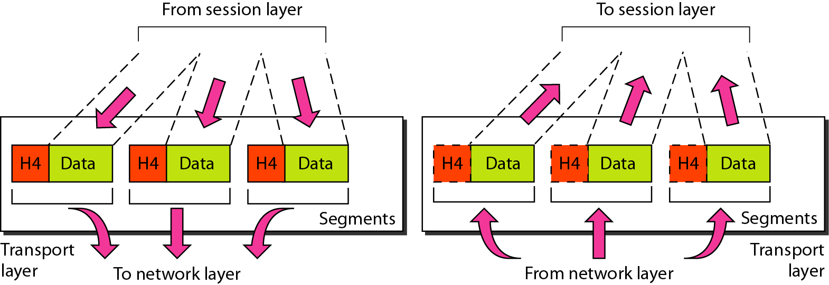
Figure 2.10 Transport layer

Slide 24
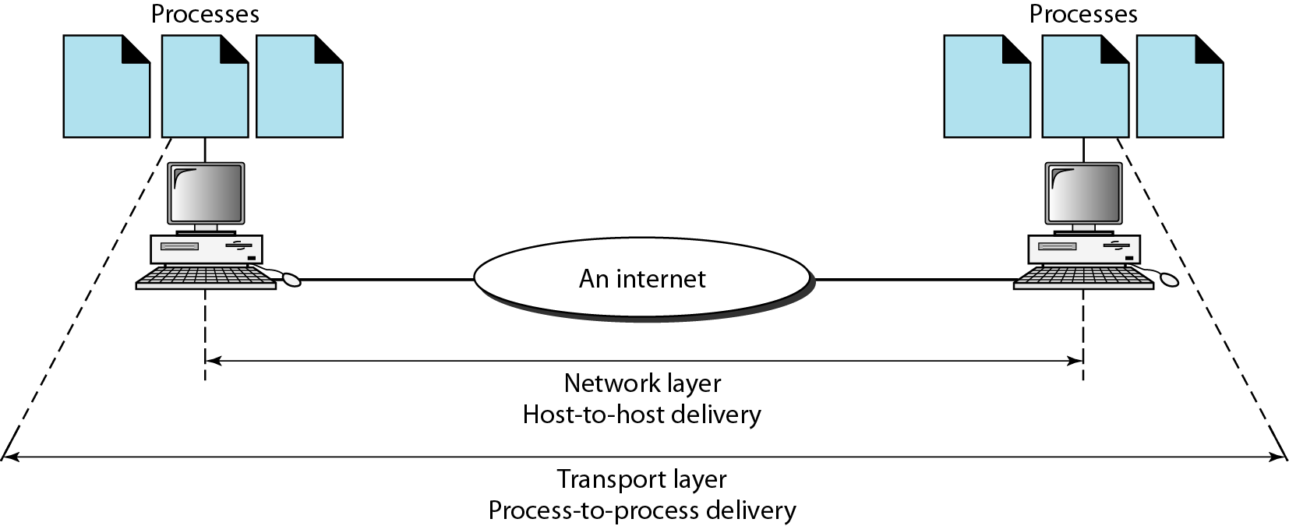
Figure 2.11 Reliable process-to-process delivery of a message

Slide 25
Functions of Session Layer (Layer-5)
The session layer is the network dialog controller.
It establishes, maintains, and synchronizes the interaction among communicating systems.
The responsibilities of the session layer includes the following:
Dialog control
Synchronization

Slide 26
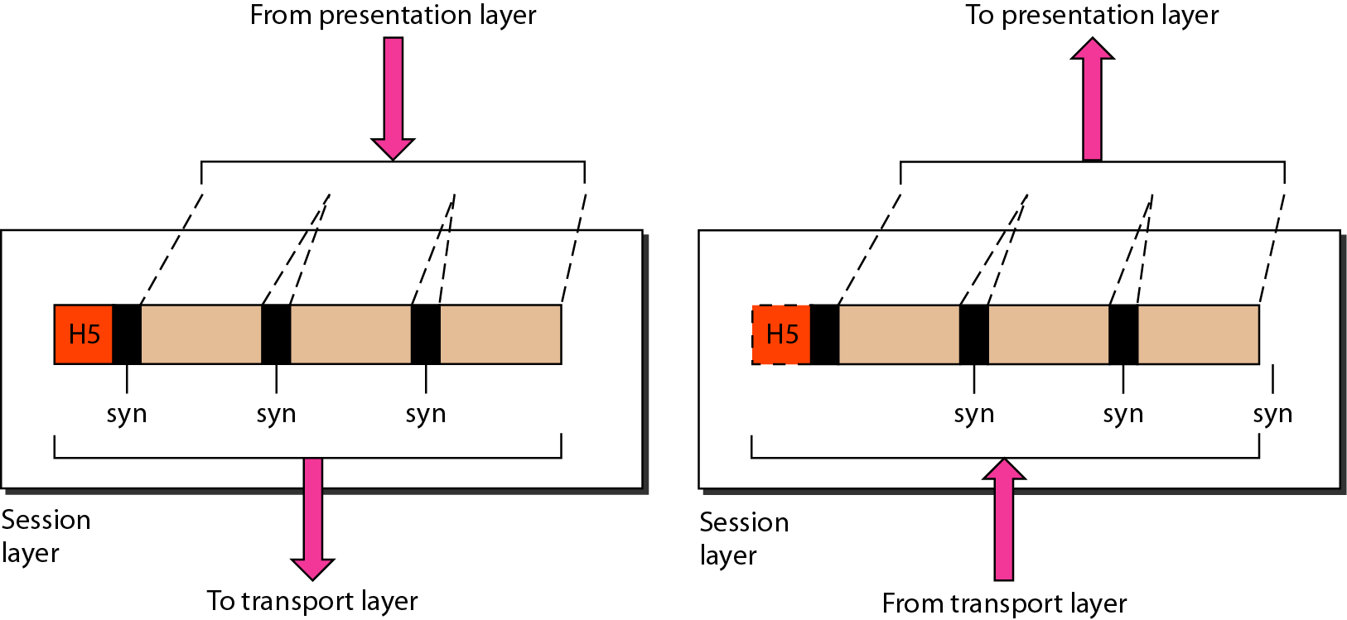
Figure 2.12 Session layer

Slide 27
Note
The session layer is responsible for dialog control and synchronization.

Slide 28
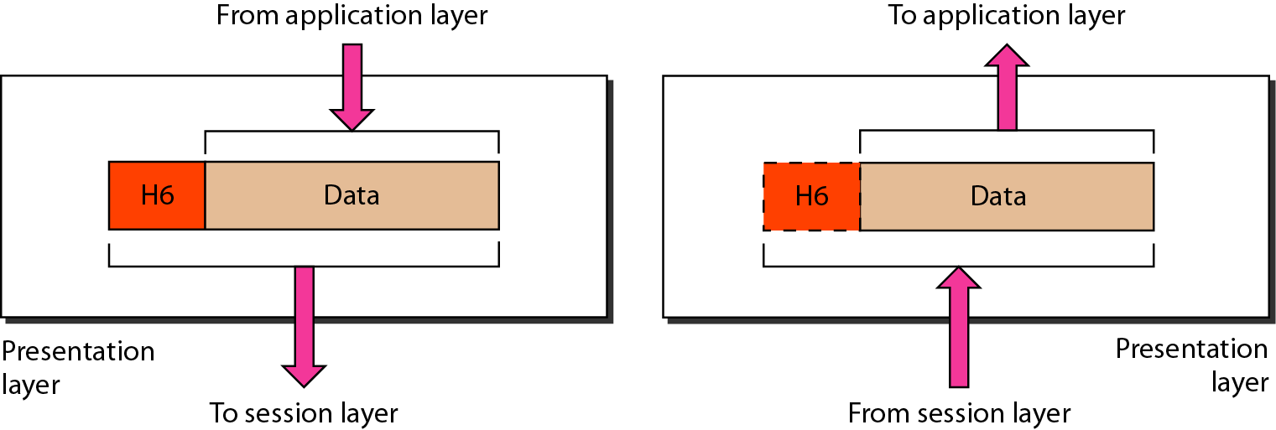
Figure 2.13 Presentation layer

Slide 29
Functions of Presentation Layer (Layer-6)
The presentation layer is concerned with the syntax and semantics of the information exchanged between two systems.
The responsibilities of the presentation layer includes the following:
Translation
Encryption
Decryption
Compression

Slide 30
Note
The presentation layer is responsible for translation, compression, and encryption.

Slide 31
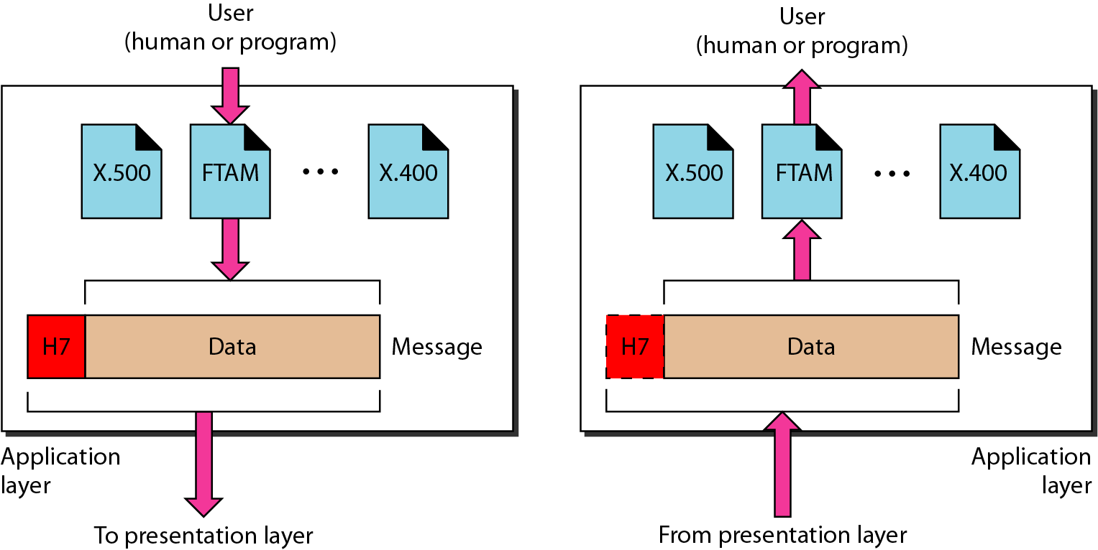
Figure 2.14 Application layer

Slide 32
Functions of Application Layer (Layer-7)
The application layer enables the user, whether human or software, to access the network.
It provides user interfaces and support for services such as electronic mail, remote file access and transfer.

Slide 33
Note
The application layer is responsible for providing services to the user.

Slide 34
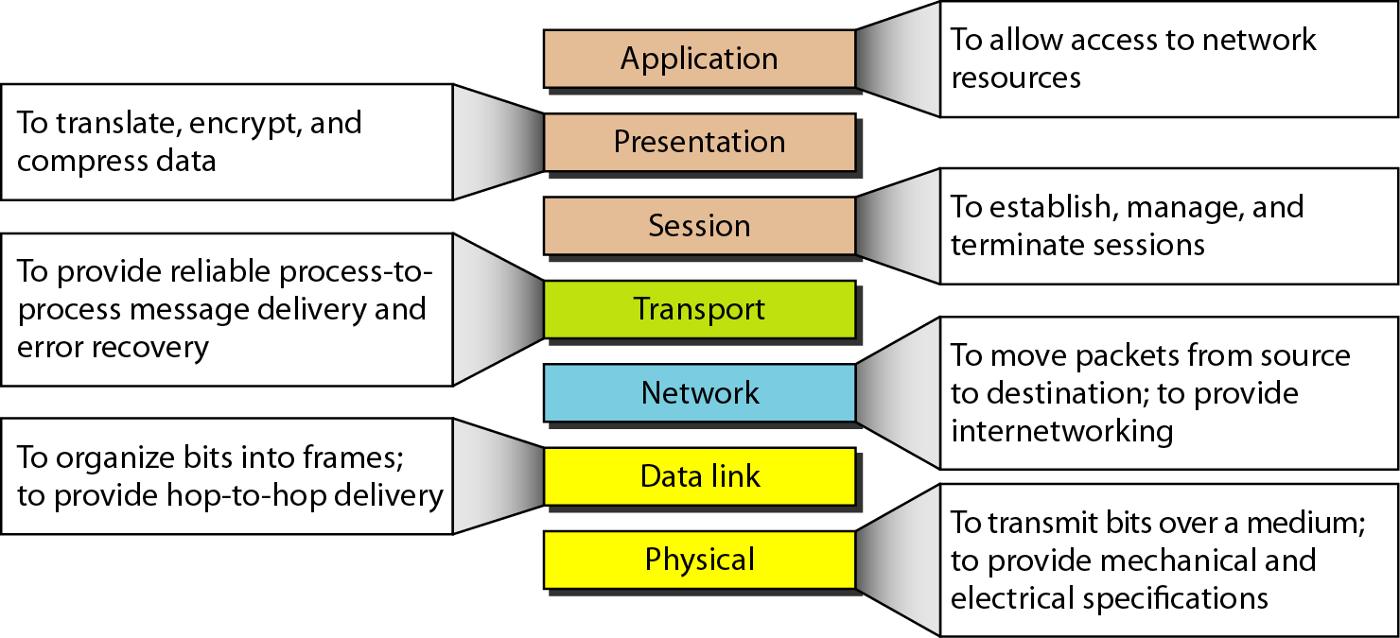
Figure 2.15 Summary of layers

